Slide 1


Create Web front-end with Angular
In this lession, you will learn:
- Angular overview
- Understanding of Component, Service, Module…
- Using TypeScript in an Angular Project
- Show List, Detail Components
- Navigation with routing
- Get data from a server

Slide 2
Angular overview
-Angular is a platform and framework for building single-page client applications using HTML and TypeScript
-NgModules, provides a compilation context for components. An app always has at least a root module & many feature modules
-A template combines HTML with Angular markup that can modify HTML elements before they are displayed
-For data or logic that isn't associated with a specific view, and that you want to share across components, you create a service class

Slide 3
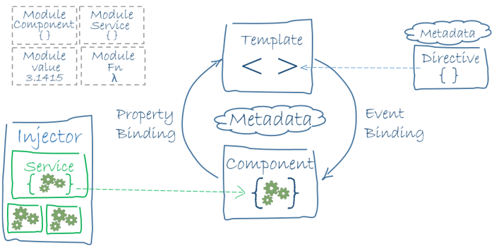
Angular diagram
The following diagram shows how these basic pieces are related

Slide 4
Create a new project
Make sure your development environment includes Node.js® and an npm package managerTo install the CLI using npm, open a terminal/console window and enter the following command
//Install the Angular CLI
~ npm install -g @angular/cli
//create new project
~ ng new my-app
//Run the application
~ cd my-app
~ ng serve --open --port 4200
The --open (or -o) option automatically opens your browser to http://localhost:4200/.

Slide 5
Angular components
Components are the fundamental blocks of Angular applications. They display data on the screen, listen for user input, and take action based on that input
import { Component } from '@angular/core’;
//This is app.component.ts, written in TypeScript(JS + type)
@Component({
  selector: 'app-root’, //in html, it will be <app-root>some content</app-root>
  templateUrl: './app.component.html’, //html file to display UI
  styleUrls: ['./app.component.css’]//CSS file for styling
})
export class AppComponent {
title = ‘Products management';
}

Slide 6
Angular components
Using the Angular CLI, you can generate a new component:
~ ng generate component products
//In products.component.ts
import { Component, OnInit } from '@angular/core’;
//... selector: 'app-products’
  export class ProductsComponent implements OnInit {
  constructor() { }
  ngOnInit() {
    //ngOnInit() is a lifecycle hook
    //which is called shortly after creating a component
  }
}
}

Slide 7
Show Component in View(html)
Using the Angular CLI, you can generate a new component:
//In ...app.component.html
<h1>{{aPropertyInAppComponentClass}}</h1>
<app-products></app-products>
//In products.component.ts
export class ProductsComponent implements OnInit {
  product: Product = { //typescript = JS + type => where is Product ?
    id: 1,
    name: 'iphone 12', //Let's define "Product" interface !
    year: 2021, //How to display these fields in products.component.html ?
  }
//...
}

Slide 8
Two-way data binding
Setup a two-way data binding between the <input> form element and the product.name property. [(ngModel)] is Angular's two-way data binding syntax
//Open AppModule (app.module.ts)
import { FormsModule,BrowserModule, } from '@angular/forms’
//...
declarations: [
HeroesComponent
],//...
//In ...products.component.html
<div>
  <label>name:
  <input [(ngModel)]="product.name" placeholder="name"/>
  </label>
</div>

Slide 9
Display a list
To list them all, add an *ngFor to the <li> to iterate through the list of objects. It repeats the host element for each element in a list.
//In ...products.component.html
<li *ngFor="let eachProduct of products" (click)="onSelect(eachProduct)">
{{eachProduct.id}}</span> {{eachProduct.name}}
</li>
//In ...products.component.ts
export class ProductsComponent implements OnInit {
  //...How to create a “fake” object lists ?
  onSelect(product: Product): void {
  this.selectedProduct = product;
  }
}

Slide 10
Inline-If Directive
The component should only display the selected product details if the selectedProduct exists.
<div *ngIf="selectedProduct">
  <h2>{{selectedProduct.name | uppercase}} Details</h2>
  <!--Some more elements-->
</div>`
Let’s try to insert ”arrow function”, “async function”,… as in JS. Test and see the result ?

Slide 11
Add services
They component should focus on presenting data and delegate data access to a service. you'll create a ProductService that all classes can use to get products
~ ng generate service product
//In product.service.ts
import { Injectable } from '@angular/core';
@Injectable({ //This class provides an injectable service
providedIn: 'root',
})
export class ProductService {
  getProducts(): Product[] {
  return "a list of faked Products";
  }
  constructor() { }
  }
}

Slide 12
Call services from other Components
They component should focus on presenting data and delegate data access to a service. you'll create a ProductService that all classes can use to get products
//In products.component.ts
constructor(private productService: ProductService) {}
//You can call service anywhere:
this.heroService.getHeroes()
//Let’s display data using Service and see the result ?

Slide 13
Observable data = “Redux replacement”
The app will fetch products from a remote server, which is an inherently asynchronous operation. Observable is one of the key classes in the RxJS library.
//In product.service.ts
import { Observable, of } from 'rxjs';
//..
getProducts(): Observable<Product[]> {
return "a list of Products"
}
//..Any other component want to see this change?
//It must "subscribe" ! => In componentA.component.ts
this.productService.getProducts().subscribe(products => {
/ /Do something with "updated products"
})

Slide 14
Navigation with routing
The best practice is to load and configure the router in a separate, top-level module that is dedicated to routing and imported by the root AppModule
~ ng generate module app-routing --flat --module=app
//In app-routing.module.ts
import { NgModule } from '@angular/core';
import { CommonModule } from '@angular/common’;//also import ProductsComponent
@NgModule({
  imports: [
  CommonModule
  ],
  declarations: []
})
export class AppRoutingModule { }

Slide 15
Navigation with routing
Add more routing configurations:
//In app-routing.module.ts
import { NgModule } from '@angular/core';
import { CommonModule } from '@angular/common’;//also import ProductsComponent
//..
const routes: Routes = [
  { path: ‘products', component: ProductsComponent }
];
@NgModule({
  imports: [RouterModule.forRoot(routes)],
  exports: [RouterModule]
})
//..

Slide 16
Add a navigation link
How to add add link in View ?
//In app.component.html
<h1>{{title}}</h1>
<nav>
<a routerLink="/products">Products</a>
</nav>
<router-outlet></router-outlet>
Now try to add more Routes and send parameters

Slide 17
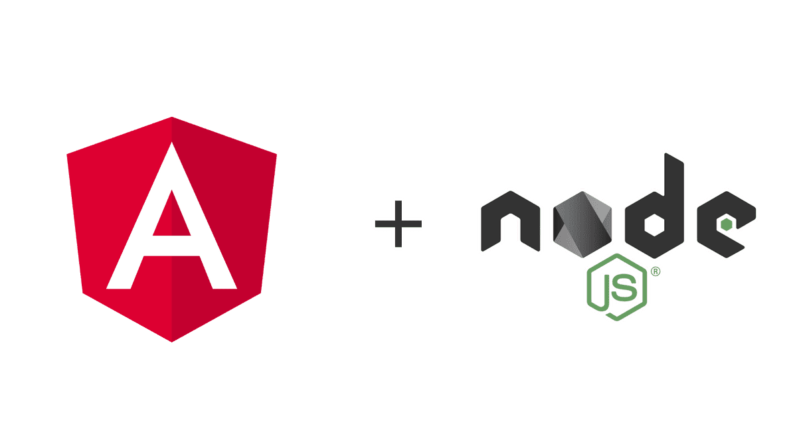
Get data from a server
You'll add the following data persistence features with help from Angular's HttpClient.
HttpClient is Angular's mechanism for communicating with a remote server over HTTP
We will practice this detail in class

Slide 18
HttpClient & HttpHeaders
In the ProductService, import HttpClient and HttpHeaders:
//In product.service.ts
import { HttpClient, HttpHeaders } from '@angular/common/http';
import { catchError, map, tap } from 'rxjs/operators’;
//inject HttpClient into the constructor
constructor(private http: HttpClient) { }
/** GET products from the server */
getProducts(): Observable<Product[]> {
  return this.http.get<Product[]>(this.productsUrl);//send GET request
  //How to handle Error? see next Slide !
}

Slide 19
handleError() method
The following handleError() method reports the error and then returns result so that the application keeps working. This method returns a function
//In product.service.ts
private handleError<T>(operation = 'operation', result?: T) {
  return (error: any): Observable<T> => {
    console.error(`${operation} failed: ${error.message}`);
    return of(result as T);
  };
}
//In getProducts:
return this.http.get<Product[]>(this.productsUrl)
  .pipe(tap(_ => this.log('successful')),
  catchError(this.handleError<Product[]>('getProducts', []))
  );

Slide 20
PUT Request with “http”
http.put() => send PUT request to Server, let’s do the same with POST
//In product.service.ts
updateProduct(product: Product): Observable<any> {
let httpOptions = { headers: new HttpHeaders({
'Content-Type': 'application/json’
}) };
  return this.http.put(this.productsUrl, product, httpOptions)
  .pipe(
      tap(_ => this.log(`updated product id=${product.id}`)),
      catchError(this.handleError<any>('updateProduct’))
  );
}
//call service in ...component.ts
save(): void {
  this.productService.updateProduct(this.product)
  .subscribe(() => this.goBack());//success or failed => goBack();
} //call in html => button (click)="save()"

Slide 21
AsyncPipe
AsyncPipe - Unwraps a value from an asynchronous primitive
#From terminal
~ ng generate component product-search //This component allows you search “live”
<div>
  <h4>Search products(live)</h4>
  <input #searchBox (input)="search(searchBox.value)" />
  <ul>
    <li *ngFor="const product of products$ | async" >
    <!--products $ is an Observable, not an array-->
      {{product.name}}
    </li>
  </ul>
</div>

Slide 22
Live search
//In product-search.component.ts
import { Observable, Subject } from 'rxjs';
import {debounceTime, distinctUntilChanged, switchMap} from 'rxjs/operators';
//In SearchComponent class
Products$: Observable<Product[]>;
private searchTerms = new Subject<string>();
search(term: string): void {
this.searchTerms.next(term);// Push a search term into the observable stream.
}
//In ngOnInit
this.Products$ = this.searchTerms.pipe(
  debounceTime(300),// wait 300ms after each keystroke
  distinctUntilChanged(),// ignore new term if same as previous term
  switchMap((term: string) => this.productService.searchProducts(term)),// switch to new search
);

Slide 23


